Slide 1
UPDATE
US 97 Corridor
McDonald Becker Roundabout Update
Toppenish City Council
Bob Hooker P.E.
WSDOT Design Office
Brian White P.E WSDOT Assistant Regional Administrator for Construction and Design
March 2021
Roger Millar, P.E., AICP, Secretary of Transportation
Keith Metcalf, P.E., Deputy Secretary of Transportation

Slide 2
Presentation Overview
Introduction
Project updates and timeline
Community engagement and roundabout education
Next steps

Slide 3
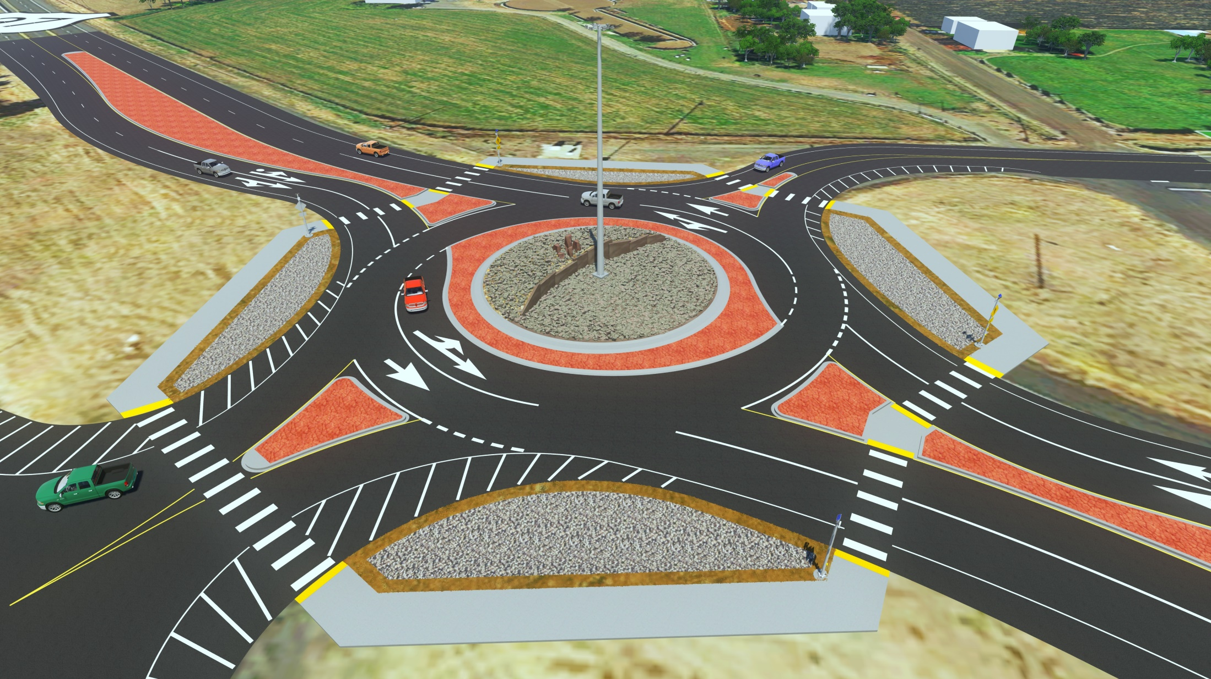
Preliminary Design US 97 McDonald/Becker

Slide 4
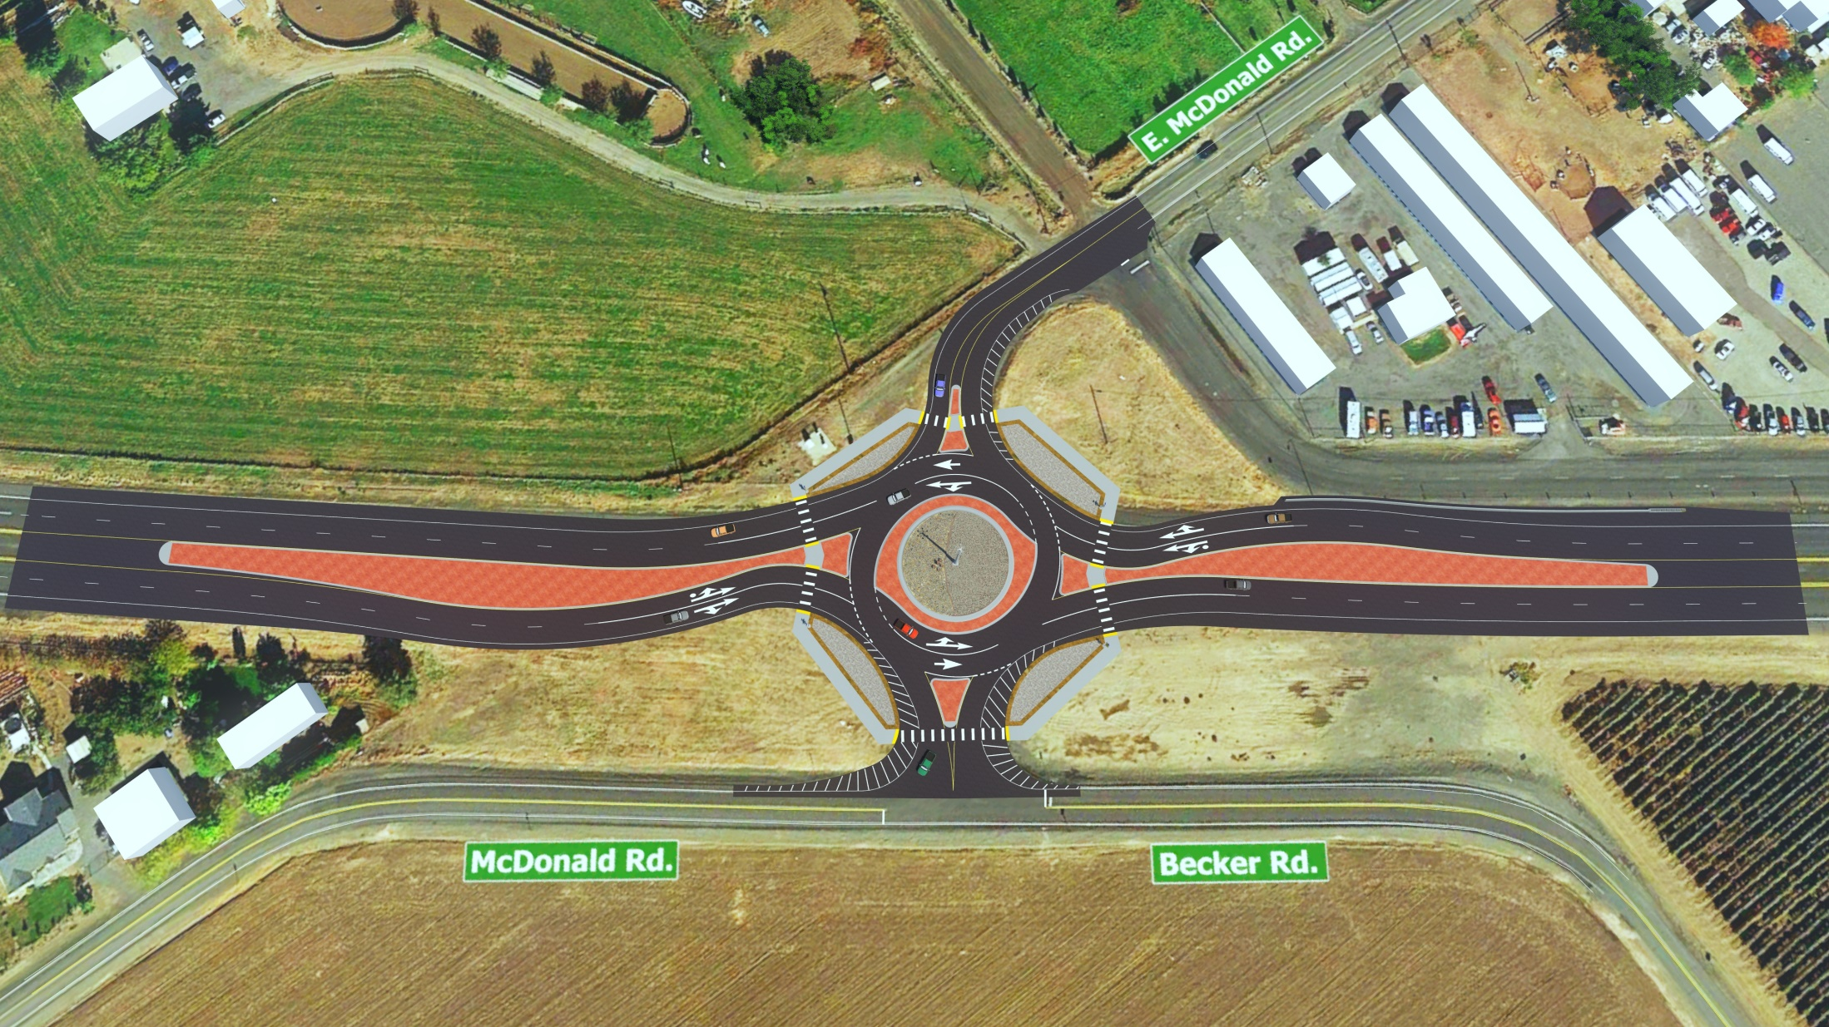
Preliminary Design US 97 McDonald/Becker

Slide 5
First Roundabout: Timeline

Slide 6
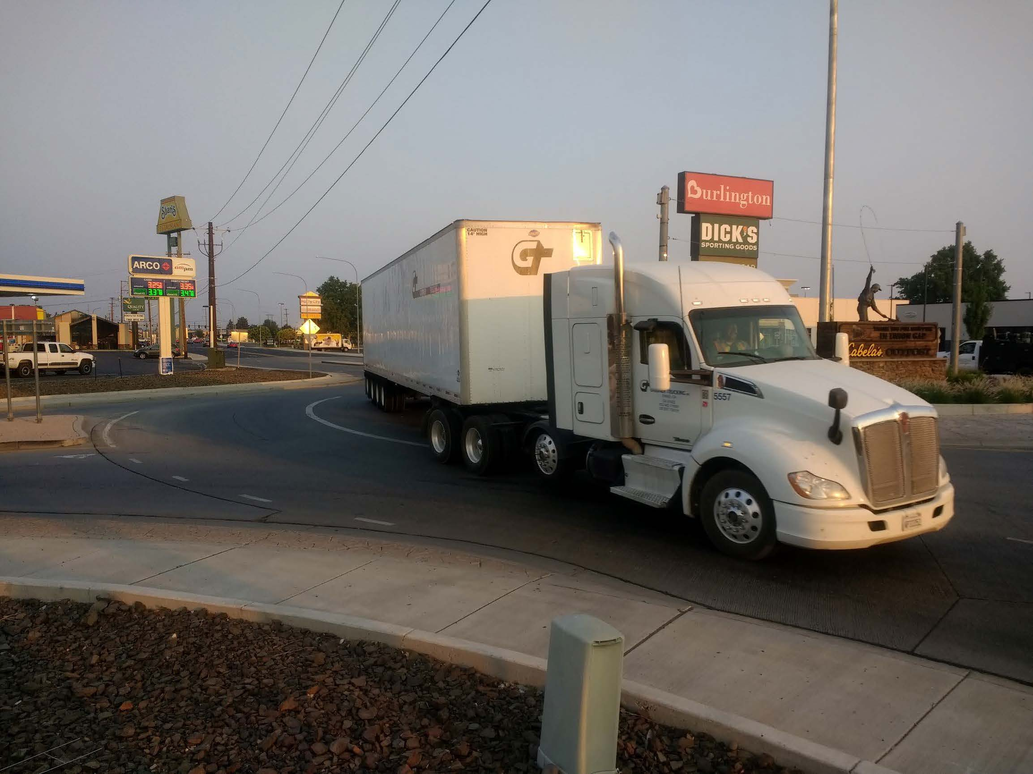
Current Progress
Peer review complete
Environmental docs, waiting for cultural report to be complete.
Geotechnical investigation & report nearly complete
Hydraulic design & report nearly completion
Advertisement timeline April 2021

Slide 7
US 97 Corridor Timeline
We are here

Slide 8
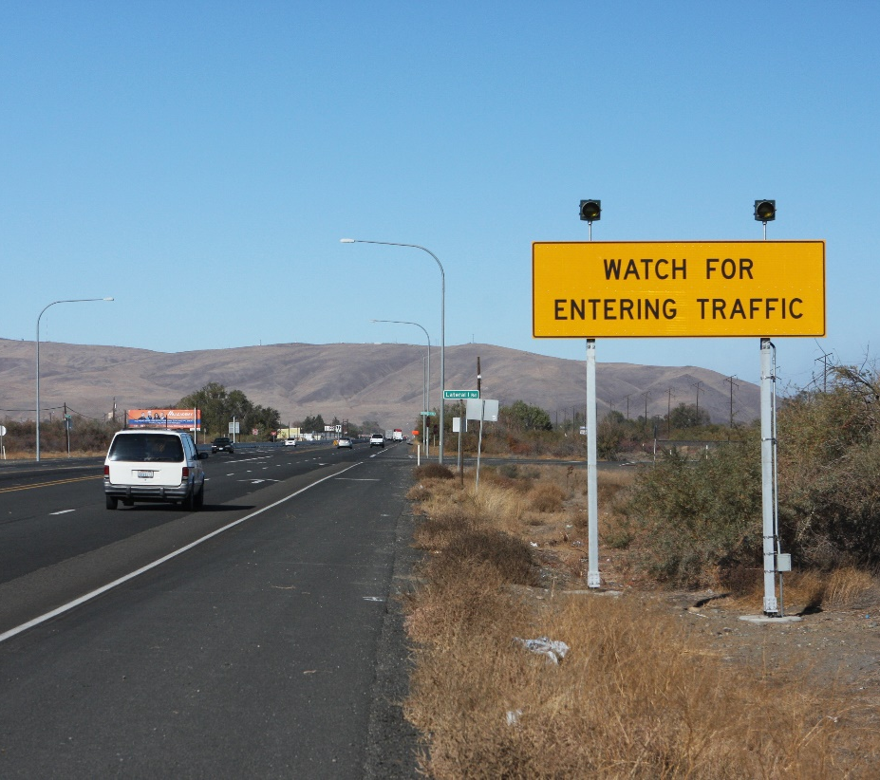
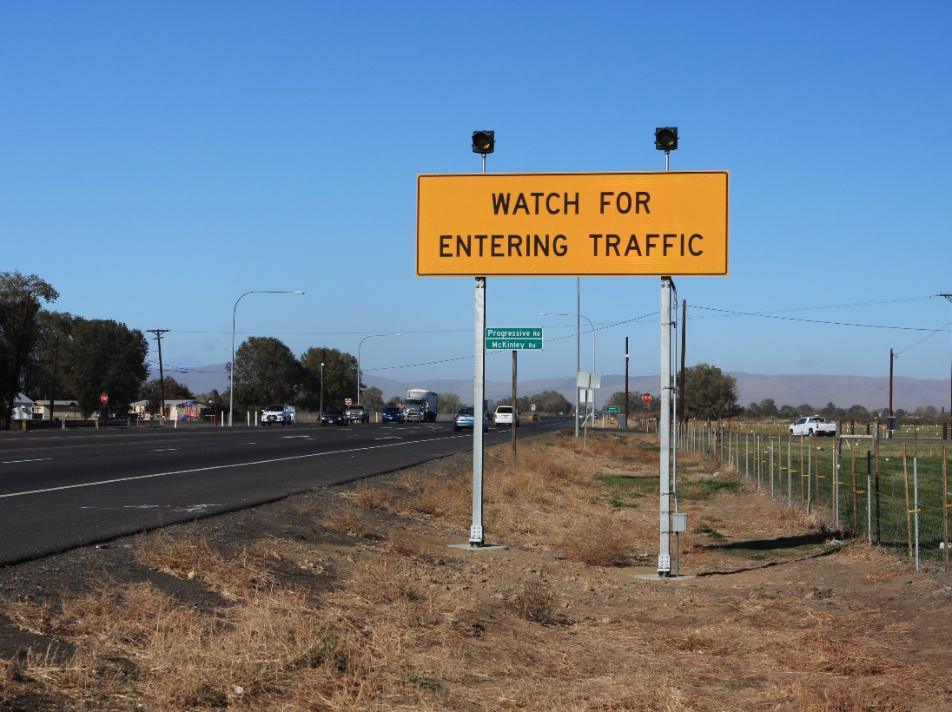
US 97 Recent IMPROVEMENTS COMPLETED
Advanced Detection Signage SR 97 Lateral 1 Road.
Advanced Detection Signage SR 97 Pogressive Road.

Slide 9
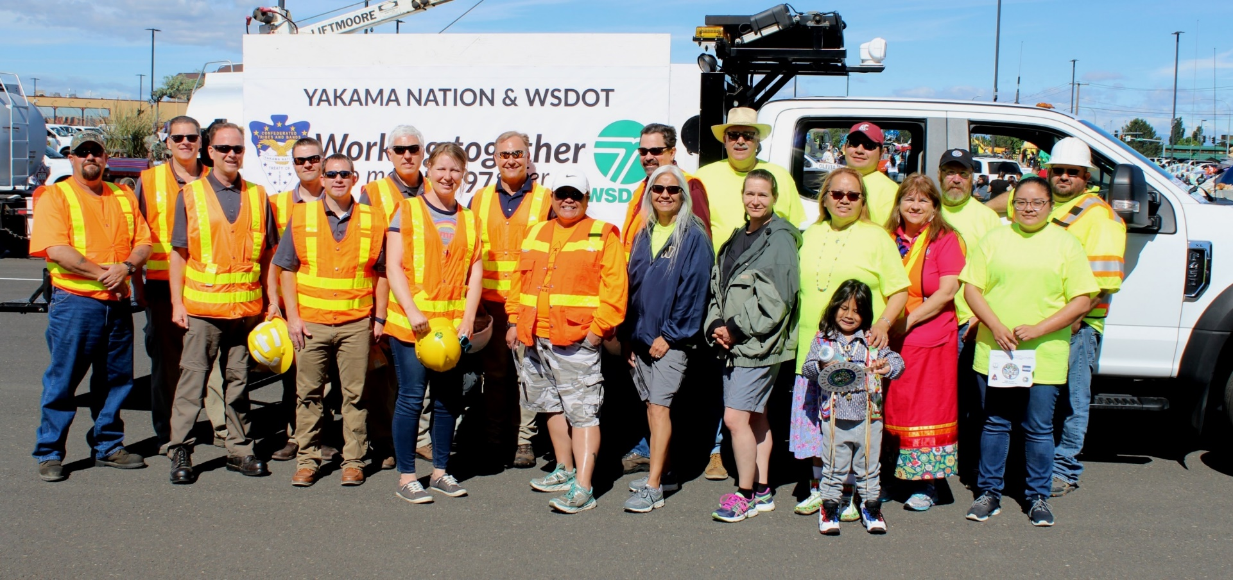
WSDOT & TTSC Partnership
Notes:
HollyAnna was kind enough to nominate the TTSC and WSDOT partnership for the 2020 WSDOT Wall of Fame. The application was accepted and we are all honorees. Thank you EVERYONE for this great opportunity to work together.
Yakama Nation TTSC - YouTube

Slide 10
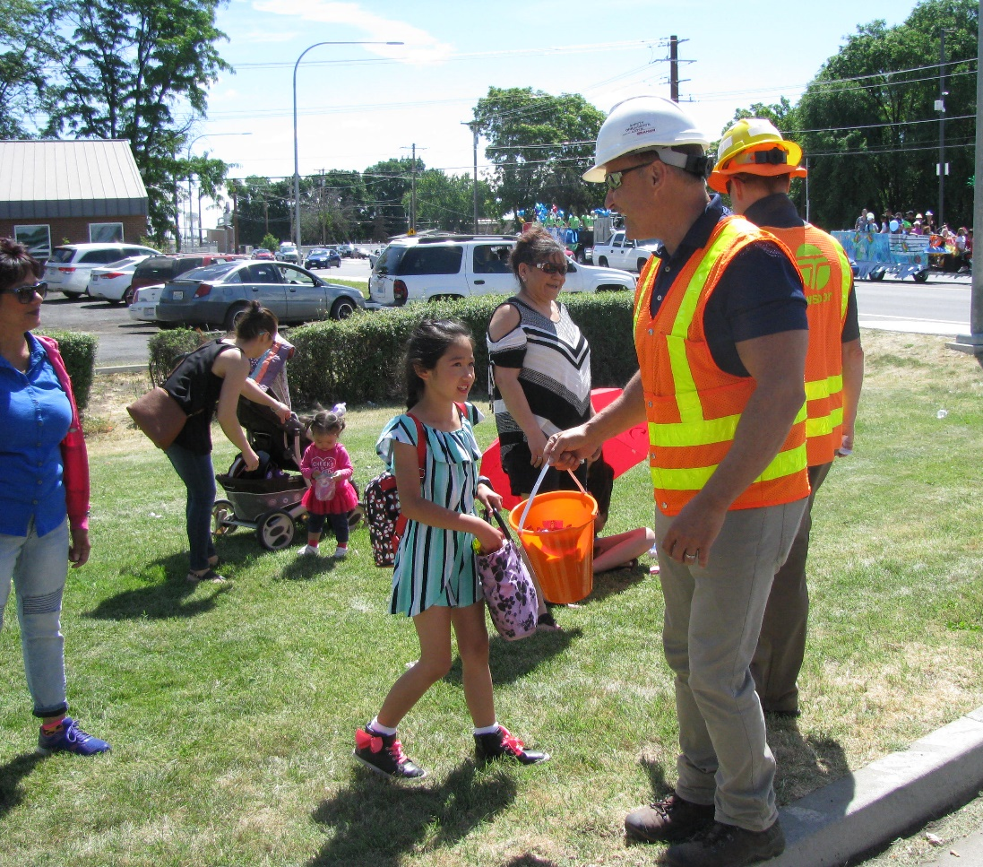
Community Engagement
Yakama Nation TERO Career Fair
MESA-CON
Yakama Nation Treaty Day Parade
City of Toppenish National Night Out
Yakama Nation Backpack Giveaway
Virtual open house January/February 2021

Slide 11
What does the community think about roundabouts?
TTSC administered surveys at community events
Over 500 survey responses
86% have a positive or neutral opinion of roundabouts

Slide 12
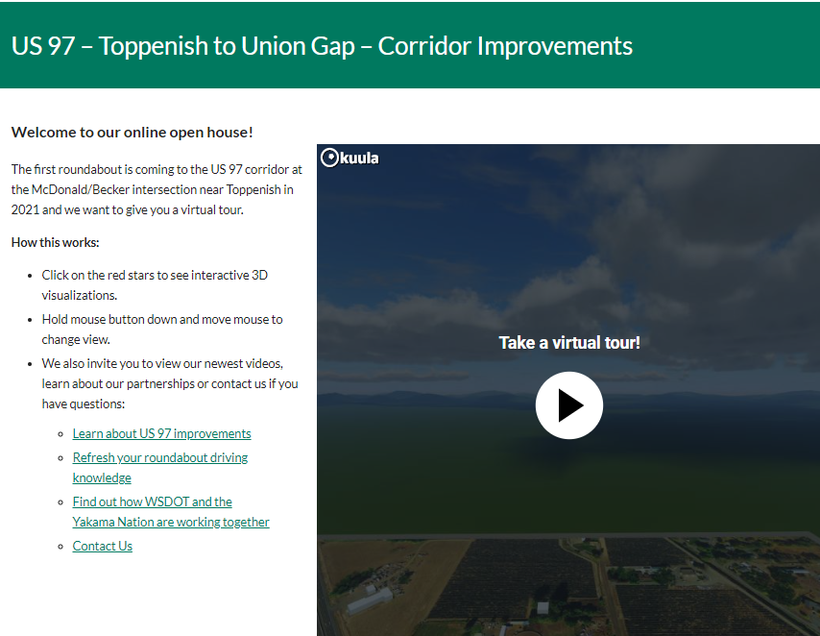
US 97 Toppenish to Union Gap Online Open House
Notes:
We hosted a US 97 online open house in February. It was covered by most media outlets in Yakima and emailed to about 5,000 people. We will do another round of messaging right before construction. Link to open house: US 97 – Toppenish to Union Gap – Corridor Improvements | WSDOT (wa.gov)

Slide 13
Learn about US 97 improvements

Slide 14
YAKAMA NATION & WSDOT
Working together ^{TO MAKE}US 97^{SAFER}
QUESTIONS?

